Slide 1
Variability modeling Using Extended System Entity Structures (SES) and Automated Model Generation
Thorsten Pawletta¹, Umut Durak², Birger Freymann¹, Artur Schmidt¹, Hendrik Folkerts¹ Christina Deatcu¹, Sven Pawletta¹
¹Wismar University of Applied Sciences Research Group CEA, Germany
²German Aerospace Center (DLR) Braunschweig, Germany
Tutorial at SpringSim‘17, Virginia Beach / VA, USA 2017 Society for Modeling & Simulation Int. (SCS)
(slides at https://www.mb.hs-wismar.de/cea/SES_Tbx/)

Slide 2
Outline
Introduction
M&S Using SES/MB Approach
Basics of SES
CEA’s Extended SES/MB Infrastructure
SES/MB Based Software Tools (Live Demo)
Summary (& Applications)
References

Slide 3
Introduction Motivation
Mercedes-Benz factory in Rastatt/DE delivered 1.1 million A-class cars between 2004 und 2005 and only 2 cars were identical.
Vast Number of Product Variants
M&S of modular, hierachical systems with a high degree of variability (Multi-Variant Systems)

Slide 4
Introduction Motivation
Multi-variant systems systems with a high degree of variability, which can be configured or extended for employment in particular context, or with an inherent dynamic structure
Typical Apps
(Software) Product Lines
Study of a Family of Systems (FoS)
Deliberative & reactive control problems
Self-Organizing/Emergent Systems
. . .

Slide 5
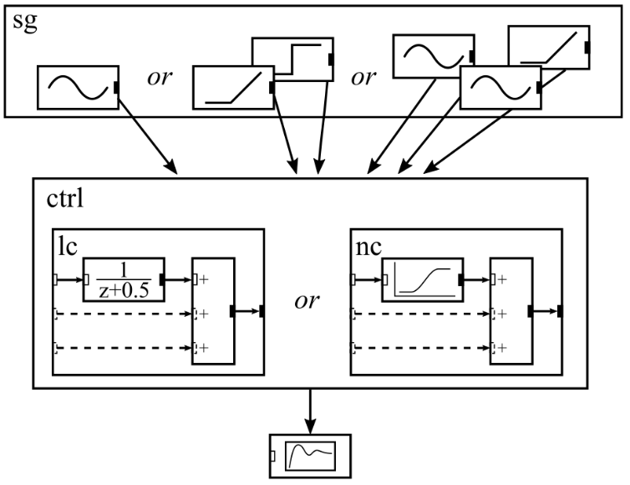
Introduction Case Study 1: Study of a Family of Systems (FoS)
Extension of an example from The MathWorks for variant modeling
Various controller designs
Diff. #of input signals
Diff. types of input signals

Slide 6
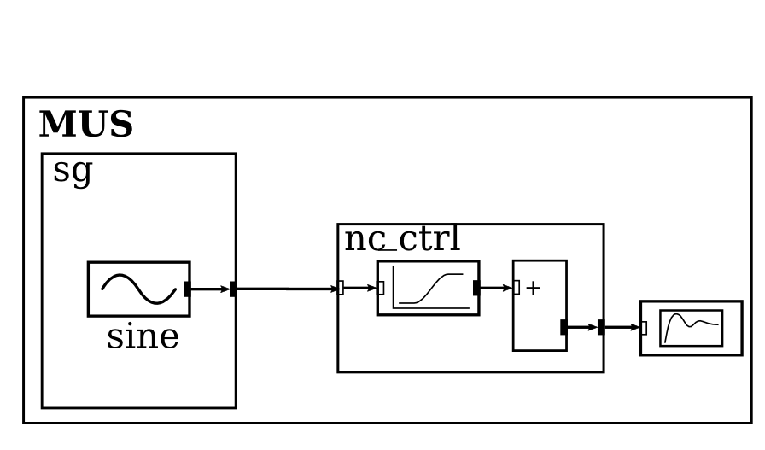
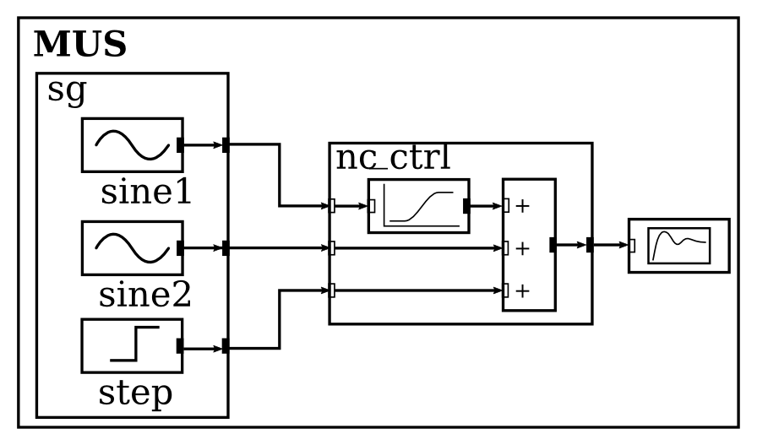
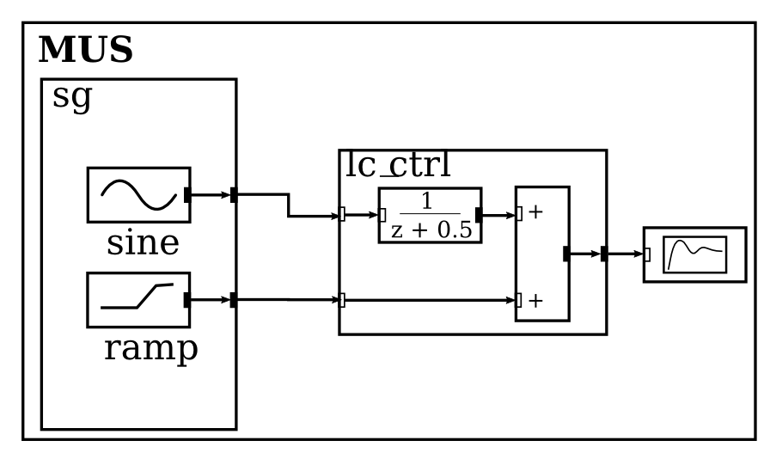
Introduction Case Study 1: Study of a FoS (Cont.)
Objective: Study several system designs
… and many more

Slide 7
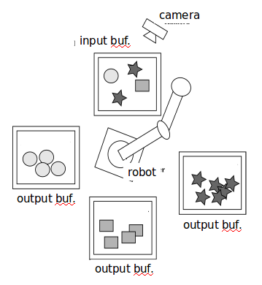
Introduction Case Study 2: Reactive Robot Control
Objective: Control for sorting parts
Reactive Control
Decomp. process & control (behavior) into simple systems
Def. conditions when systems should act & stop (coordinator)
coordinator
cameraor
sen- sors
actu-
ators
robotor
buffersor
identificat.r
Inherent structure dynamics!
sorting {pick, place}

Slide 8
Introduction Approaches for Variant Modeling
150% models
Delta modeling
Feature-oriented model-driven development
. . .
Variable structure modeling (Dynamic Structure Sys., Multimodel/Model Update, Agents, . . .)
System Entity Structure/Model Base approach (SES/MB)

Slide 9
Outline
Introduction
M&S Using SES/MB Approach
Basics of SES
CEA’s Extended SES/MB Infrastructure
SES/MB Based Software Tools (Live Demo)
Summary (& Applications)
References

Slide 10
M&S Using SES/MB Approach Terms
System Entity Structure (SES) introduced by B.P. Zeigler [Z1984]
SES continually developed, e.g. [RZ1993, ZPK2000, ZH2007, ZS2013, CEA2015]
SES itself is a formal ontology
SES model is a metamodel (in this case a variability model) that specifies a set of system designs (structure, params) for a specific problem
Model Base (MB) is a set of basic models (library with configurable dynamic models)

Slide 11
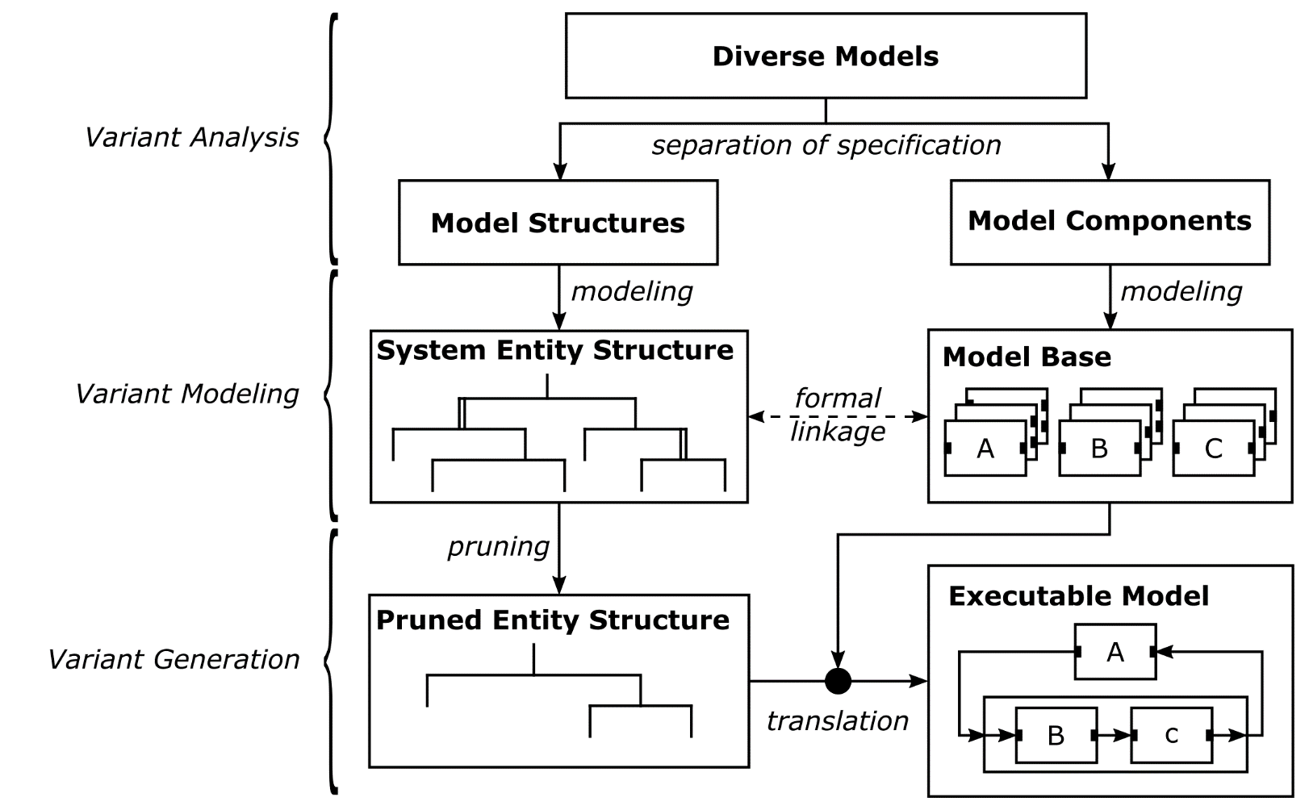
M&S Using SES/MB Approach Overview
Multi-variant System
Variant Management
build
SES/MB Framework

Slide 12

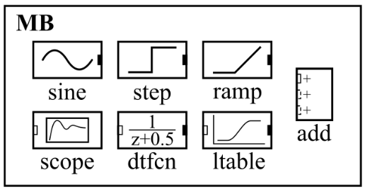
M&S Using SES/MB Approach SES/MB for Simplified Case Study 1
Various controller designs
Diff. #of signal sources
Only 1 signal type!
→ 6 system structures
SES is a tree={ nodes, edges, attributes}
Node (edge) types:
Entity (|)
Aspect (|)
Multi Aspect (|||)
Specialization (||)
SES
lc
nc

Slide 13
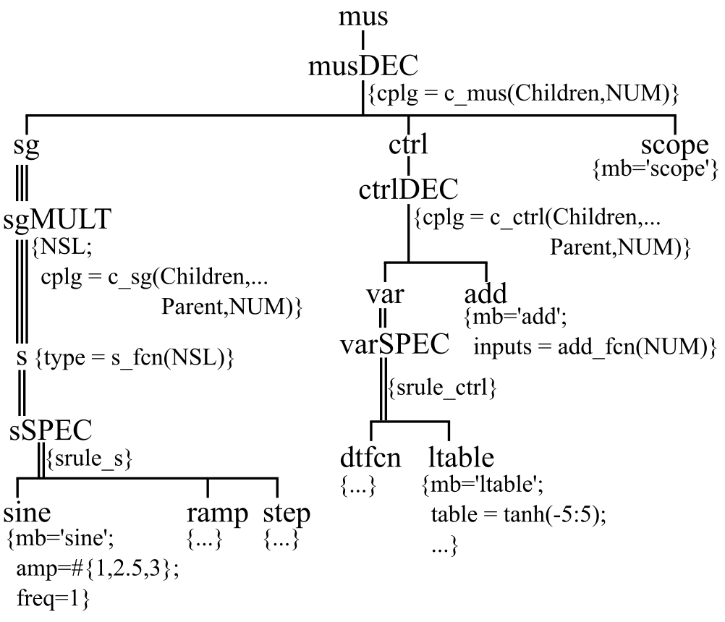
M&S Using SES/MB Approach SES & MB for CS1
SES
MODELING
lc
nc
lc
nc

Slide 14
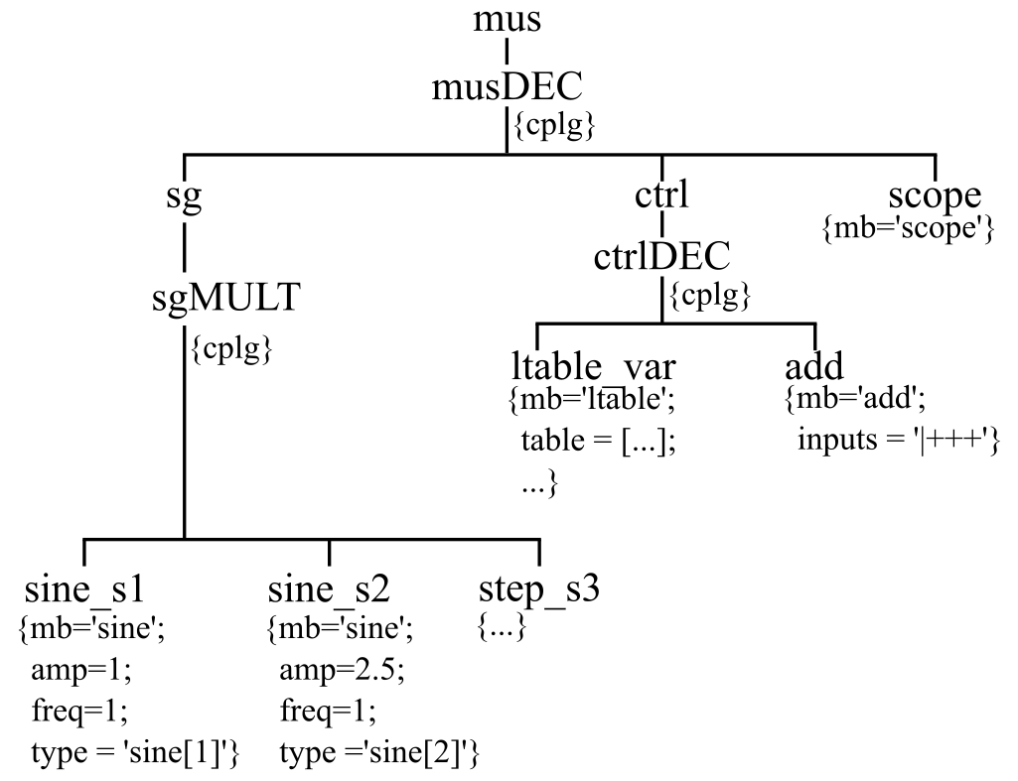
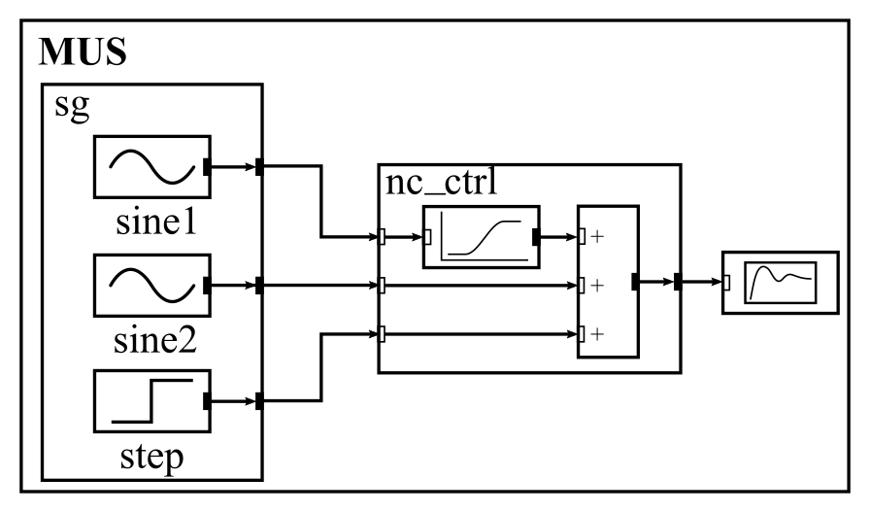
M&S Using SES/MB Appr. Basic Pruning & Build Operation for CS1
pruning derives PES (one system configuration) from SES
build generates simulation model (SM) from PES & MB
PES
SES
pruning
nc_var
MODELING
build
SM
lc
nc
mus
ctrl
sine_s1
sine_s2
lc
nc
step_s3

Slide 15
Outline
Introduction
M&S Using SES/MB Approach
Basics of SES
CEA’s Extended SES/MB Infrastructure
SES/MB Based Software Tools (Live Demo)
Summary (& Applications)
References

Slide 16
Basics of SES Tree Elements
Tree={ nodes, edges, attributes}
Nodes
root, inner, leaves

Slide 17
Basics of SES Tree Elements
Tree={nodes, edges, attributes}
Nodes
root, inner, leaves
Edges

Slide 18
Basics of SES Tree Elements
Tree={nodes, edges, attributes}
Nodes
root, inner, leaves
Edges
path

Slide 19
Basics of SES Tree Elements
Tree={nodes, edges, attributes}
Nodes
root, inner, leaves
Edges
path
Attributes

Slide 20
Basics of SES Nodes & Edge Types
Entity nodes (|edges)
Represent objects of a real or imaginary world
(root and leaf nodes are always of type entity)
in SES/MB context:
entities represent basic or coupled systems (or abstract systems)
leaf nodes are linked with basic systems in MB
entity attributs define system parameters
MB
C3
E
C2
C1
coupled
abstract
F
D
basic
G
H

Slide 21
Basics of SES Node & Edge Types
Descriptive nodes (edge type)
Characterize (parent – children) entity nodes
Aspect (Dec) (|)
Aspect Siblings
Specialization (Spec) (||)
Multi Aspect (|||)

Slide 22
Basics of SES Node & Edge Types
Aspect (Dec)
Describes composition of a system (has-a)
Attribute describes coupling relations (EIC, IC, EOC) couplings={(from, to), (from, to), …. }
A
B
C
D
E
F

Slide 23
Basics of SES Node & Edge Types
Aspect (DEC) Siblings
Describes alternatives (variants) for composing a system (xor)
Attribute aspect rule defines an xor decision
A
B
C
D
E
F
A
B
G
H
C
D

Slide 24
Basics of SES Node & Edge Types
Multi Aspect (MAspect)
Describes composition of a system using replication of succeding entity (incl. substructure)
Attribute numRep= #of replications Attribute couplings={(from, to), … }
A
Ds
B
C
D1
numRep=1
A
Ds
B
C
D1
numRep=2
D2
numRep=3
A
Ds
B
C
D1
D2
D3

Slide 25
Basics of SES Node & Edge Types
Specialization (Spec)
Describes taxonomy of a system (is-a)
Aggregation of parent & selected child entity
Attribute selection rule describes an xor decision
A
B
C1_C
D
A
B
C2_C
D
A
B
C3_C
D

Slide 26
Basics of SES Node & Edge Types
Selection Constraints
Defined by directed edges
Specify cross tree selections
Can be combined with selection rules or aspect rules
A
B1_B
C2_C
D
A
B2_B
C1_C
D
selection constraints

Slide 27
Basics of SES Summary of Basic Tree Elements
Entity
Many more (advanced) features:
Specialization Siblings
Specialization & Aspect Siblings
. . .
(see [ZH2007])
Aspect (Dec), Aspect Siblings
Specialization
Multi Aspect, (Siblings same as Asp.)
Selection Constraints
{Attributes}

Slide 28
Basics of SES 6 Axioms
Alternating mode
Valid brothers
Strict hierarchy
Attached variables (attributes)
Inheritance
Uniformity

Slide 29
Basics of SES Axioms
Alternating mode
Entity and descriptive nodes alternate in the tree
(root and leaves are always of type entity)
Entity
Aspect
|
Specialization
||
Multi Aspect
|||

Slide 30
Basics of SES Axioms
Valid brothers
Siblings must have different names.

Slide 31
Basics of SES Axioms
Attached variables (attributes)
Variables of the same type attached to the same node must have different names.

Slide 32
Basics of SES Axioms
Inheritance (aggregation during pruning)
Parent entity of a specialization inherits name, attributes and subtree of selected child entity (in the fig. without subtree)
both SES are equivalent because of attribute inheritance

Slide 33
Basics of SES Axioms
Strict hierarchy
All nodes in a path must have different names.
(only some SES extensions allow recursion, see axiom Uniformity)

Slide 34
Basics of SES Axioms
Uniformity
Nodes having the same name in different path specify isomorphic sub-trees.
leaf node B is expanded

Slide 35
Basics of SES Axioms
Uniformity (cont.)
Expansion of former leaf node B with isomorphic subtree.

Slide 36
Basics of SES Axioms
Pitfall! Uniformity (UF) & Strict Hierarchy (SH)
(UF) nodes having the same name specify isomorphic sub-trees
(SH) all nodes in a path must have different names
Violation of strict hierarchy axiom after node expansion!

Slide 37
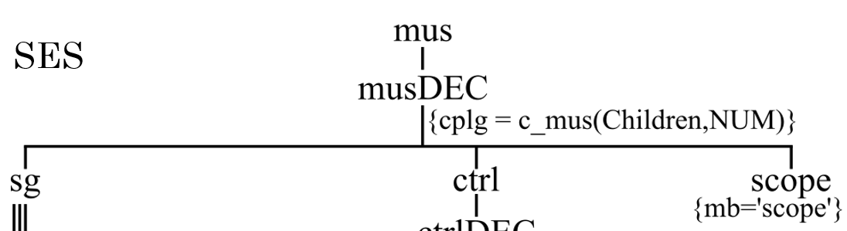
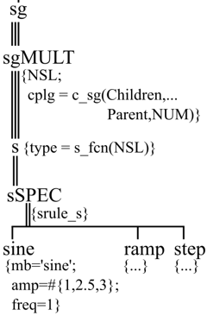
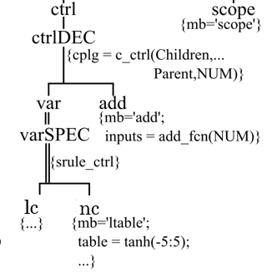
Basics of SES Methods
Merging
Merge several SES (e.g. modular modeling CS1)

Slide 38
Basics of SES Methods
Pruning
Solve all decisions to derive a Pruned Entity Structure (PES), describing an unique system variant
Aspect Siblings: select one sibling
Specialization: select one child & aggregate with parent
Multi Aspect: replicate child and select corresponding couplings
Respect tree crosss selection constrains
. . .

Slide 39
Basics of SES Methods
PES
Pruning Example
Take A, ADec, B
Select B1Dec subtree
Select C1 & aggregate with C
Resolve DMultiAspect
Pruning
MultiAspect↔Aspect
renaming D→{D1,D2}, (valid brothers axiom)
SES
Pruning with numRep=2

Slide 40
Basics of SES Methods
PES
Pruning SES → PES
Flattening PES → FPES resolve inner entity nodes
FPES

Slide 41
Outline
Introduction
M&S Using SES/MB Approach
Basics of SES
CEA’s Extended SES/MB Infrastructure
SES/MB Based Software Tools (Live Demo)
Summary (& Applications)
References

Slide 42
CEA’s Extended SES/MB Infrastructure Objectives & Extensions
Objectives
Keep a lean SES tree for “big“ variability problems
Pragmatic usage for solving engineering problems (“closed loop“ reactive framework)
Extensions
Attribute mb for flexible links betw. SES nodes and basic models in MB
SES functions (SESfcn)
Global SES Variables (SESvars) as input interface for SES/MB
Semantic Conditions on SESvars
Implicit vars Parent, Children for each node
Experiment Control Unit (EC) & Execution Unit (EU)
SESfcn extend the SES by procedural knowledge

Slide 43
…Extended SES/MB Infrastructure Specific Attribute mb
mb
mb links leaf nodes with basic models
pruning
MB
E
F
G
H
D
C1
C2
C3
build (model generation)

Slide 44
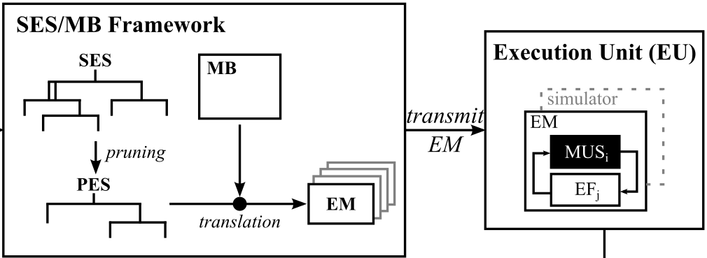
…Extended SES/MB Infrastructure Classic SES/MB Framework [ZPK2000]
transformation methods
pruning derives PES (one system config.) from SES
build generates simulation model (SM) from PES & MB
Simulator
SM
pruning
SM
SM
build
results

Slide 45
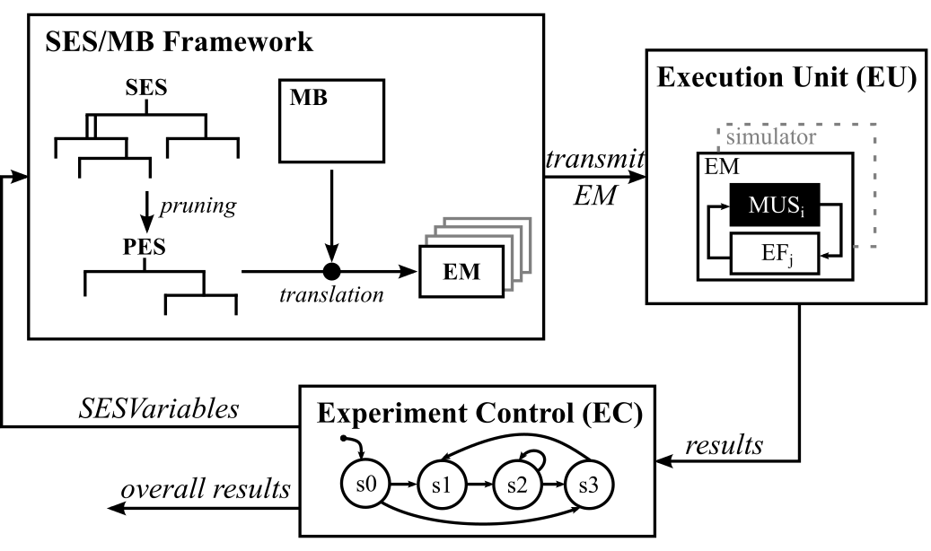
…Extended SES/MB Infrastructure “Closed Loop“ Reactive Framework [CEA2015]
SES Variables (SESvars) as input arg. for SES/MB framework
overall Experiment Control (EC) unit
Execution Unit (EU) for Simulation Models (SM)
pruning
SM
SM
SM
build
PES=pruning(SESvars), SM=build(PES,MB)
transmit(SM),
config(simulator), simulate()
results

Slide 46
…Extended SES/MB Infrastructure Remember Case Study 1
New Objective: Automated study of different system designs
(find best design for a given reference trajectory)

Slide 47
…Extended SES/MB Infrastructure Principle of Automation of Case Study 1
Exp. Control set SESvars NSL={‘sine[1]‘,‘sine[2]‘,‘step‘}; NUM=3; CTRL=‘nc‘
results
Execution Unit simulate SM
SESVars
PES
SES
pruning
nc_var {mb=‘ltable‘; table=[...];
transmit SM
MODELING
build
SM
lc
nc
mus
ctrl
sine_s1
sine_s2
dtfcn
ltable
step_s3

Slide 48
…Extended SES/MB Infrastructure SESvars & Semantic Conds for CS 1
SESvars={CTRL, NSL, NUM} with
CTRL ϵ {‘lc‘,‘nc‘} --type of controller
NSL ϵ {(i),(i,j),(i,j,k} | --list of sig. types i ϵ {‘sine[x]‘,‘ramp‘,‘step‘}∧ j ϵ {‘sine[x]‘,‘ramp‘,‘step‘}∧ k ϵ {‘sine[x]‘,‘ramp‘,‘step‘}∧ x ϵ {1,2,3} } --type of sine config
NUM ϵ {1,2,3} | NUM=numel(NSL) --#of signals
Ex. for a Semantic Cond. to exclude CTRL=‘lc‘ & NUM=3
~(CTRL==‘lc‘ & NUM==3)
Example for valid SESvar settings and method calls CTRL={‘nc‘};NSL={‘sine[1]‘,‘sine[2]‘,‘step‘};→ NUM=3 PES=pruning(CTRL,NSL,NUM), SM=build(PES,MB)

Slide 49
…Extended SES/MB InfrA Selection Rules or Aspect Rules (CS 1)
mus
ctrl
This selection needs a rule.
Rules depend on SESvar settings.
srule_ctrl={ CTRL==‘lc‘→ lc | CTRL==‘nc‘→ nc }
lc
lc
nc
nc

Slide 50
…Extended SES/MB Infrastructure Variable Couplings Using SESfcn (CS 1)
mus
couplings depend on #of signals
Variable couplings are coded
with SESfcn (in MATLAB style)
ctrl
function cplg=c_mus(childr,num)
. . .
%set variable cplg btw sg & ctrl
for i=1:num
%FROM_Sys, PORT_No cplg(i,1:4)={childr{1},num2str(i),… %TO_Sys, PORT_No
childr{2},num2str(i)}; end
%set fixed cplg btw ctrl & scope
cplg(num+1,1:4)={childr{2},. . .
return
lc
SESfcn are executed during pruning
lc
nc
nc

Slide 51
…Extended SES/MB Infrastructure Spec. of Sys. Param. Using SESfcn & Multisets (CS 1)
mus
ctrl
Variable parameter configs.
(including variable #ports)
are defined using
multisets & SESfcn.
lc
lc
nc
nc
The full case study was published
at SCS SpringSim/ANSS 2016.

Slide 52
Outline
Introduction
M&S Using SES/MB Approach
Basics of SES
CEA’s Extended SES/MB Infrastructure
SES/MB Based Software Tools (Live Demo)
Summary (& Applications)
References

Slide 53
SES/MB Based Software Tools Overview
MS4Me (RTSync Corp. / ACIMS)
. . .
RG CEA
MATLAB/Prolog SES tbx. (MATLAB/DEVS, Simulink)
MATLAB SES tbx. (MATLAB/DEVS, Simulink/SE/SF/Simscape, Modelica for Dymola & OpenModelica, Xcos)
(WIP) Python/PyQt SES tbx. (analogous to MATLAB SES tbx)

Slide 54
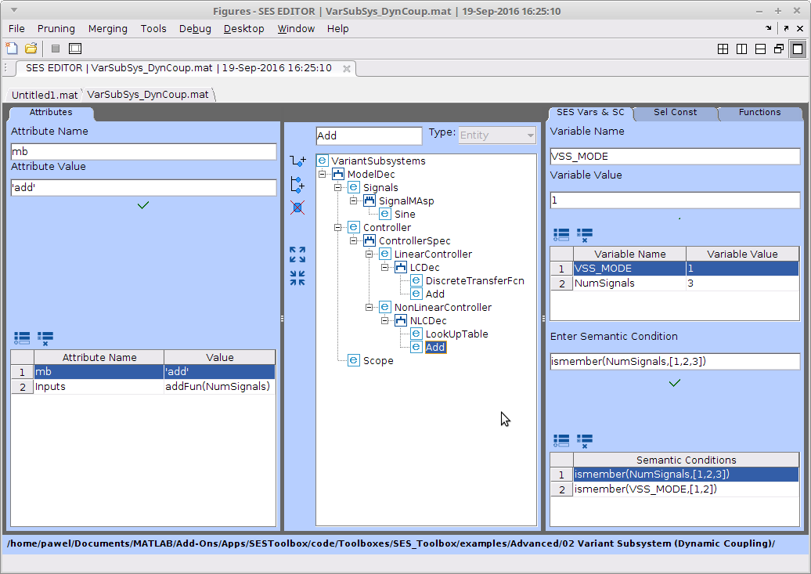
SES/MB Based Soft. Tools SES Editor GUI within MATLAB
globals SESvars, fcn, Semantic Cond.
local node attr.
SES tree

Slide 55
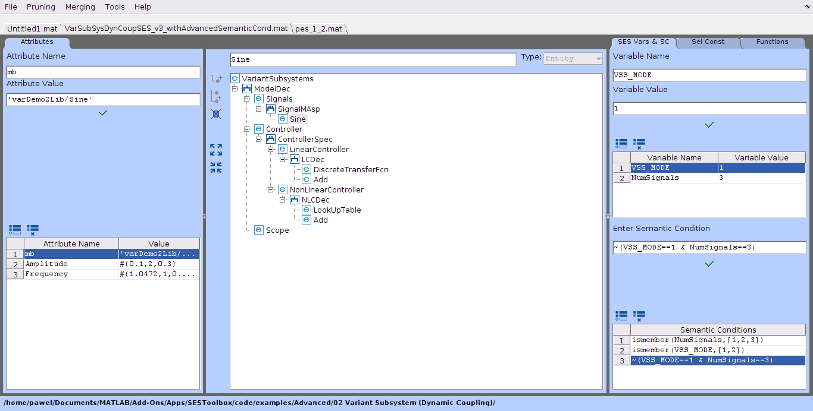

SES/MB Based Soft. Tools Semantic Cond. & Meth. CheckPruningPermission

Slide 56
SES/MB Based Soft. Tools Summary for Working with MATLAB SES tbx.
Build your MB {SL, SE, SSC blocks, user-def. models}
Model SES with GUI-based editor
SES, PES, FPES are MATLAB data struct. (exp. to XML)
All methods (pruning, ...) are callable in editor | from MATLAB
Generic model builder for Simulink & MATLAB/DEVS (Dymola, Open Modelica, Xcos (WIP))
“Closed loop“ experiments with an EC (e.g. via MATLAB script)
Tbx. includes step-by-step examples with online doc
Some restrictions for pruning (no Specialization Siblings, ...)

Slide 57

Old Yoga Wisdom
1% is theory
99% are practice

Slide 58
SES/MB Based Soft. Tools Live Demo of MATLAB SES Tbx
Introductory Examples
Reactive “Closed Loop Study“ of simplified CS1
Objective: Find best design for a given reference signal (min. variance of amp.)
Experiment Control (EC):
Def. of ref. signal
Study systems from simple to complex (1 x sine & lc_ctrl → 3 x sine & nc_ctrl)
STOP a ctrl type, if it overshoots ref. sig.
Determine system with min. variance

Slide 59
SES/MB Based Soft. Tools Live Demo of MATLAB SES Tbx
Introductory Examples
Advanced study of (simplified )CS1
Objective: Find best design for a given reference signal (min. variance of amp.)
Experiment Control (EC):
Def. of ref. signal
Study systems from simple to complex (1 x sine & lc_ctrl → 3 x sine & nc_ctrl)

Slide 60
SES/MB Based Soft. Tools Live Demo of MATLAB SES Tbx
Introductory Examples
Reactive “Closed Loop Study“ of simplified CS1
Objective: Find best design for a given reference signal (min. variance of amp.)
Experiment Control (EC):
Def. of ref. signal
Study systems from simple to complex (1 x sine & lc_ctrl → 3 x sine & nc_ctrl)

Slide 61
SES/MB Based Soft. Tools Live Demo of MATLAB SES Tbx
Introductory Examples
Reactive “Closed Loop Study“ of simplified CS1
Objective: Find best design for a given reference signal (min. variance of amp.)
Experiment Control (EC):
Def. of ref. signal
Study systems from simple to complex (1 x sine & lc_ctrl → 3 x sine & nc_ctrl)
etc.

Slide 62
SES/MB Based Soft. Tools Live Demo of MATLAB SES Tbx
Introductory Examples
Reactive “Closed Loop Study“ of simplified CS1
Objective: Find best design for a given reference signal (min. variance of amp.)
Experiment Control (EC):
Def. of ref. signal
Study systems from simple to complex (1 x sine & lc_ctrl → 3 x sine & nc_ctrl)
STOP a ctrl var, if it overshoots ref. sig.

Slide 63
SES/MB Based Soft. Tools Live Demo of MATLAB SES Tbx
Introductory Examples
Reactive “Closed Loop Study“ of simplified CS1
Objective: Find best design for a given reference signal (min. variance of amp.)
Experiment Control (EC):
Def. of ref. signal
Study systems from simple to complex (1 x sine & lc_ctrl → 3 x sine & nc_ctrl)
STOP a ctrl var, if it overshoots ref. sig.
Finaly, output the best system design

Slide 64
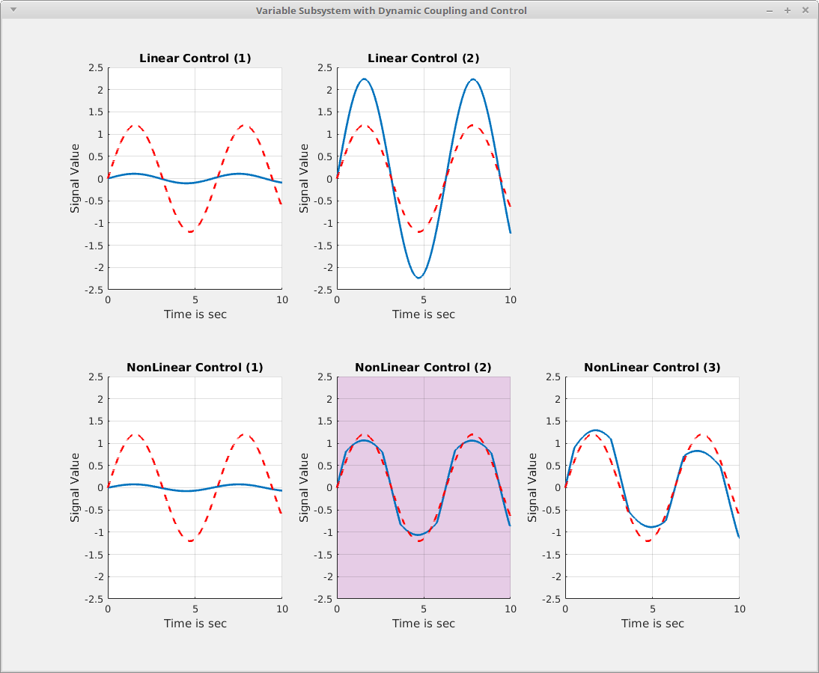
SES/MB Based Soft. Tools Live Demo of MATLAB SES Tbx
Results of the study
(1)
(3)
Overshoot! Study of lc_ctrl
was stopped!
Best
system
design!
(2)
(4)
(5)

Slide 65
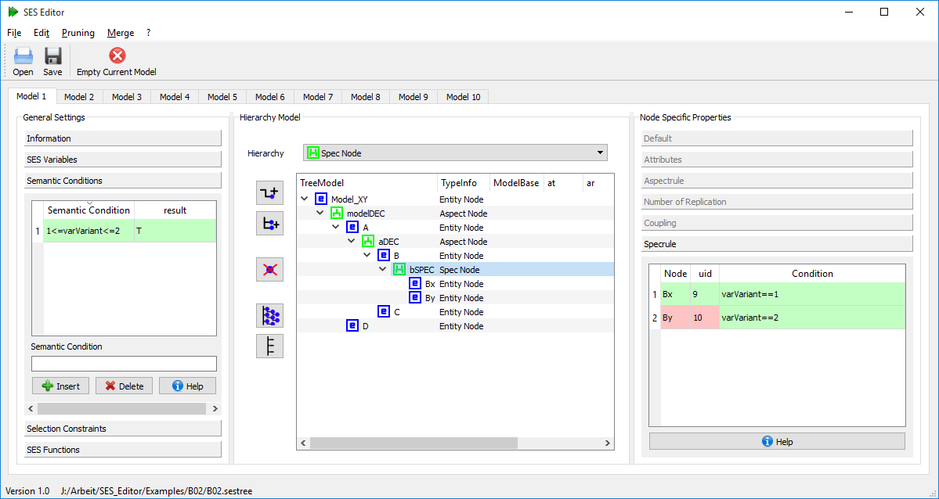
SES/MB Based Soft. Tools SES Editor GUI with PyQt (WIP)
SES, PES, FPES export to XML

Slide 66
Outline
Introduction
M&S Using SES/MB Approach
Basics of SES
CEA’s Extended SES/MB Infrastructure
SES/MB Based Software Tools (Live Demo)
Summary (& Applications)
References

Slide 67
Summary
SES specifies a set of system designs (structure & parameters)
MB organizes a set of basic models
SES/MB framework defines transformation methods such as
merging, pruning, flattening, build
PES or FPES defines a unique system config
Extended SES/MB Infrastructure
extends SES by procedural knowledge (SESfcn)
extends framework by SES Variables & new comps for “closed loop“ experiments
MATLAB SES tbx. supports
interactive modeling of SES & integration of MATLAB fcn.
export of PES or FPES in XML
transformation methods such as merging, pruning & flattening
generic model builder for Simulink & MATLAB/DEVS models (others are WIP)
Python/PyQt SES tbx. (WIP)

Slide 68
Overv. of Apps of Extend. SES/MB Infra (RG CEA & Partners)
Simulation Based Parameter and Structure Optimzation
PhD Thesis, O. Hagendorf (2009)
Advanced Robot Controls Based on SES/MB Approach
PhD Thesis G. Maletzki (2014), Project T. Schwatinski (2015), PhD Project B. Freymann (in Work)
Model Based Planing of Energy Efficient Process Chains in Manufacturing Using System Entity Structures
DFG Project, Coop. with P. Junglas PHTW Diepholz/DE
Variant Management of Complex Simulation Experiments
PhD Project A. Schmidt (in Work)
Variant Management for Aviation Problems
Coop. with U. Durak, DLR Germany
Variant Management & Model Generation of Physical-Models
Coop. with LJMU Liverpool/UK & P. Junglas PHTW Diepholz/DE (in Work)

Slide 69
References
[Z 1984] B.P. Zeigler (1984). Multifaceted Modeling and Discrete Event Simulation, Academic Press
[RZ1993] J.W. Rozenblit, B.P. Zeigler (1993). Representing and Constructing System Specifications Using the System Entity Structure Concepts, Winter Sim. Conf., 604-611
[ZPK 2000] B.P. Zeigler, H. Prähofer, T.G. Kim (2000). Theory of Modeling and Simulation, Academic Press
[ZH 2007] B.P. Zeigler, P.E. Hammonds (2007). Modeling and Simulation-Based Data Engineering, Academic Press
[ZS 2013] B.P. Zeigler, H.S. Sarjoughian (2013). Guide to Modeling and Simulation of Systems of Systems, Springer Pub.
[TP 2014] T. Pawletta, D. Pascheka, et al. (2014). Ontology-Assisted System Modeling and Simulation within MATLAB/Simulink. SNE Simulation Notes Europe, ARGESIM/ASIM Pub. TU Vienna, Austria, 24(2)-8/2014, 59-68
[CEA 2015] T. Pawletta et al. (2015). SES Toolbox for MATLAB/ Simulink, RG CEA, Wismar Univ. of Appl. Sc., Germany https://www.mb.hs-wismar.de/cea/SES_Tbx/
[TS 2016] T. Pawletta, A. Schmidt et al. (2016). Extended Variability Modeling Using System Entity Structure Ontology within MATLAB/Simulink. Proc. SCS Int. SpringSim/ANSS‘16, Pasadena/CA, USA, SCS , 62-69.

Slide 70
The End
Thanks for coming!
Questions?
The MATLAB SES Tbx. is available for free after registration by email at
https://www.mb.hs-wismar.de/cea/SES_Tbx/

Slide 71
Backyard

Slide 72
Introduction Main Approaches
Approach from M&S theory
Metamodel (MM) of system configurations & model base (MB) with basic models & transformation methods
result are minimal SMs; easier to handle
complexity of transformation methods
methods & tools: SES/MB, UML, MS4Me, CoSMoS, MATLAB/SES tbx.
M&S stepwise by hand
Appoaches from Software Eng.
150% SM with variation points & variant model (VM) & transformation methods
150 % SM is hard to handle
consistency of SM & VM
methods & tools: FM, VariantManager, PureVariants, …
delta modeling
...

Slide 73
Introduction Metamodel, Formal Ontology, Model Base
Def (by W. Pidcock & M. Uschold):
Metamodel (MM) explicit model to build a set of specific models based on terms & rules
Formal Ontology (FO) language to express something within a domain of interest (e.g. to build metamodels)
System Entity Structure (SES) itself is a FO for specifying sets of system configs for different domains
an SES model is a MM specifies a set of system configs for a specific problem
Model Base (MB) is a set of configurable dynamic models (basic models)

Slide 74
Einleitung
SES 1984 von Bernard P. Zeigler eingeführt
Abbildung einer Menge modular-hierarchischer Modellstrukturen für die Systemsimulation
2007 Erweiterung auf „Modeling & Simulation-Based Data Engineering“ [ZH 2007]
Modell
Submodell
A
B
C
F
D

Slide 75
Einleitung
Die System Entity Structure (SES) ist eine Ontologie [ZH 2007] zur Erstellung von Metamodellen
Ein SES Modell ist ein beschrifteter Baum
Definiert durch:
Knoten
Kanten
Axiome
alternating mode
valid brothers
strict hierarchy
attached variables
inheritance
uniformity
Entity
Aspect
Multi-Aspect
Specialization
Knoten-/Kantenattribute

Slide 76
Einleitung
SES/MB Framework nach [ZPK 2000] zur Modellierung & Generierung einer Menge ausführbarer Simulationsmodelle

Slide 77
Basics of SES Types of Nodes & Edges (ER Diag)
nodes
root
leaf
inner
is of type
is of type
is of type
descriptive
entity
is of type
(if no leaf)
with
aspect
multi aspect
specialization
with
with
with
| line
|| line
||| line
edges

Slide 78
Basics of SES Sumary
an SES describes a family of system structures
Simple SES with 3 variation points specifies 18 system structures
Pruning an SES to derive Pruned Entity Structures (PES)
a PES describes one unique system structure

Slide 79
Pruning an SES → PES Pruning with Selection Constrains
SES
tree cross over constrains
local selection rules are reduced
if entity F is selected, then entity C1 has to be chosen.
if entity H is selected, then entity C2 has to be chosen

Slide 80
Pruning an SES → PES Pruning with Selection Constrains (cont.)
PES
Pruning
SES
Pruning mit numRep=2

Slide 81
Modelgenerierung
Erstellen einer Model Base (MB)
Model Base
E
F
G
H
D
C1
C2
C3

Slide 82
Modelgenerierung
Erstellen einer SES
Menge von Modellstrukturen

Slide 83
Modelgenerierung
Built Operation durch einen Modellgenerator
Übergabe der PES oder FPES und MB
Model Base
E
F
G
H
D
C1_C
C2_C
C3_C
Modellgenerator

Slide 84
Modelgenerierung
Modellgenerator erzeugt ein simulatorabhängiges, ausführbares, modular-hierarchisches (PES) oder abgeflachtes (FPES) Modell
Modellgenerator
A
B
E
F
C1_C
D

Slide 85
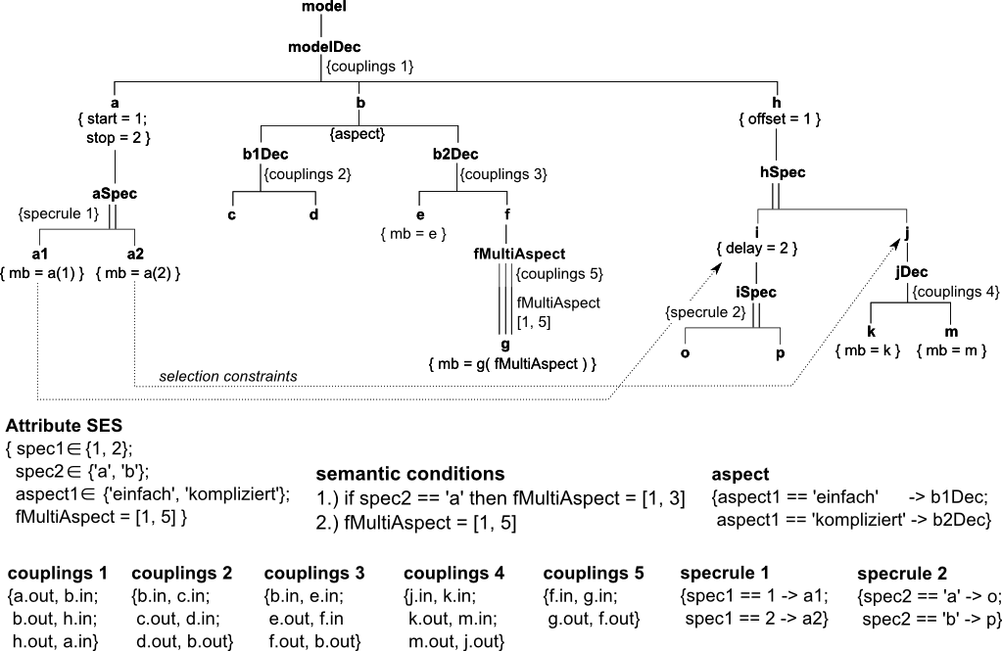
M&S Using SES/MB Appr. Example of an SES
Extended System Entity Structure [CEA 2015], specifying 2x2x5=20 system structures
Notes:
Variablen zu den Blättern hinzufügen und Konstruktoren entfernen

